Slide 1

Fiber connectors and couplers
Interconnection
Temporary - connector
Permanent - Splicing
An optical fiber connector is a flexible device that connects fiber cables requiring a quick connection and disconnection.
The fiber – to – fiber coupling efficiency is given as
common mode volume Mcommon
ME is number of modes in fiber which launches power into next fiber
The fiber – to – fiber coupling loss LF is given as – LF = -10log ηF
The main components of an optical fiber connector are
a ferrule
sub-assembly body
Cable
stress relief boot and
connector housing.

Slide 2
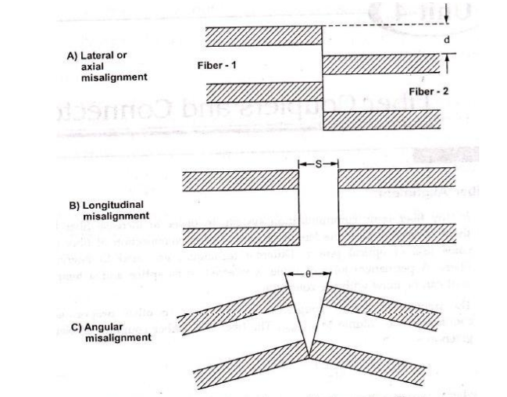
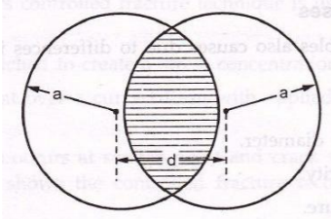

Alignment losses
Lateral / Axial misalignment
Longitudinal misalignment
Angular misalignment

Slide 3
Losses in Fiber cables are due to
Variation in core diameter
Core area ellipticity
NA variations
RI profile variations
Core cladding losses
Different types of defects
LIP – short protrusion in the core that prevents fibers coming together
Roll off – Rounding off at the edges of the fiber
Chip – Localised fiber fracture in the core
Hackle – irregularities at the fiber ends
Mist – This is the local grad
Step – abrupt changes in fiber end surfaces
Shattering – Result of maximum load on the fiber which cause fractures which is irreparable

Slide 4
The principal requirements of a good connector design are as follows:
Low losses
Interchangeability
Ease of assembly
Low environmental sensitivity
Low-cost and reliable construction
Ease of connection

Slide 5
Butt Joint Connectors
Butt joint connectors employ a metal, ceramic or molded plastic ferrule for each fiber and a precision sleeve into which the ferrule fit.
The fiber is epoxied into a precision hole which has been drilled into the ferrule.
They are of two type: Straight Sleeve and Tapered Sleeve.
In Straight sleeve connector, the length of the sleeve and a guide ring on the ferrules determine the end separation of fibers.
• In tapered sleeve, it uses a tapered sleeve to accept and guide tapered ferrules.
• Again the sleeve length and guide rings maintain a given fiber-end separation.

Slide 6
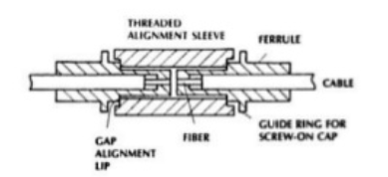
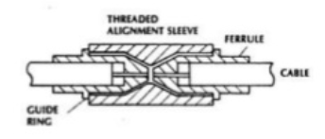

Slide 7
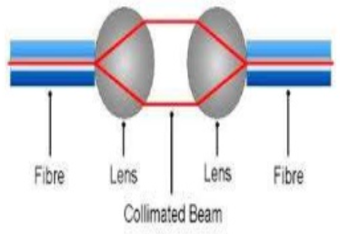
EXPANDED BEAM CONNECTOR
It employs lenses on the ends of the fibers.
These lenses either collimate the light from transmitting fiber or focus the expanded beam onto the core of the receiving filter.
Fiber to lens distance = focal length of lens.
Advantages:
• Connector is less dependent on lateral alignments.
• Beam splitters and switches can be easily inserted into expanded beam between fiber ends.

Slide 8
Splicing
A permanent or semi permanent connection between two individual optical fibers.
The process of joining two fibers is called as splicing.
Splice is used outside the buildings and connectors are used to join the cables within the buildings.
Splices offer lower attenuation and lower back reflection than connectors and are less expensive.
Types of Splicing
Fusion splicing.
Mechanical splicing / V groove

Slide 9
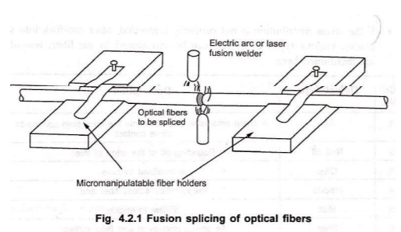
Fusion (Electric Arc Fusion ) Splicing

Slide 10
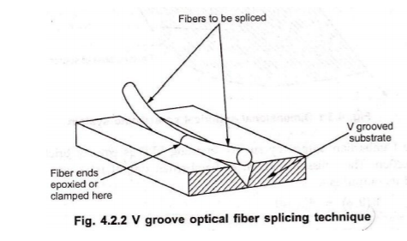
Mechanical Splicing / V Groove

Slide 11
Couplers
A fiber optic coupler is a device used in optical fiber systems with one or more input fibers and one or several output fibers.
Used to split or combine optical signals
Couplers combines two inputs at different wavelengths into one output without exhibiting significant loss
It is not possible to combine two or more inputs of the same optical frequency into one single-polarization output without significant excess losses.
Types of Couplers
Y or Tap coupler
T coupler
Star Coupler
Directional
Nondirectional

Slide 12
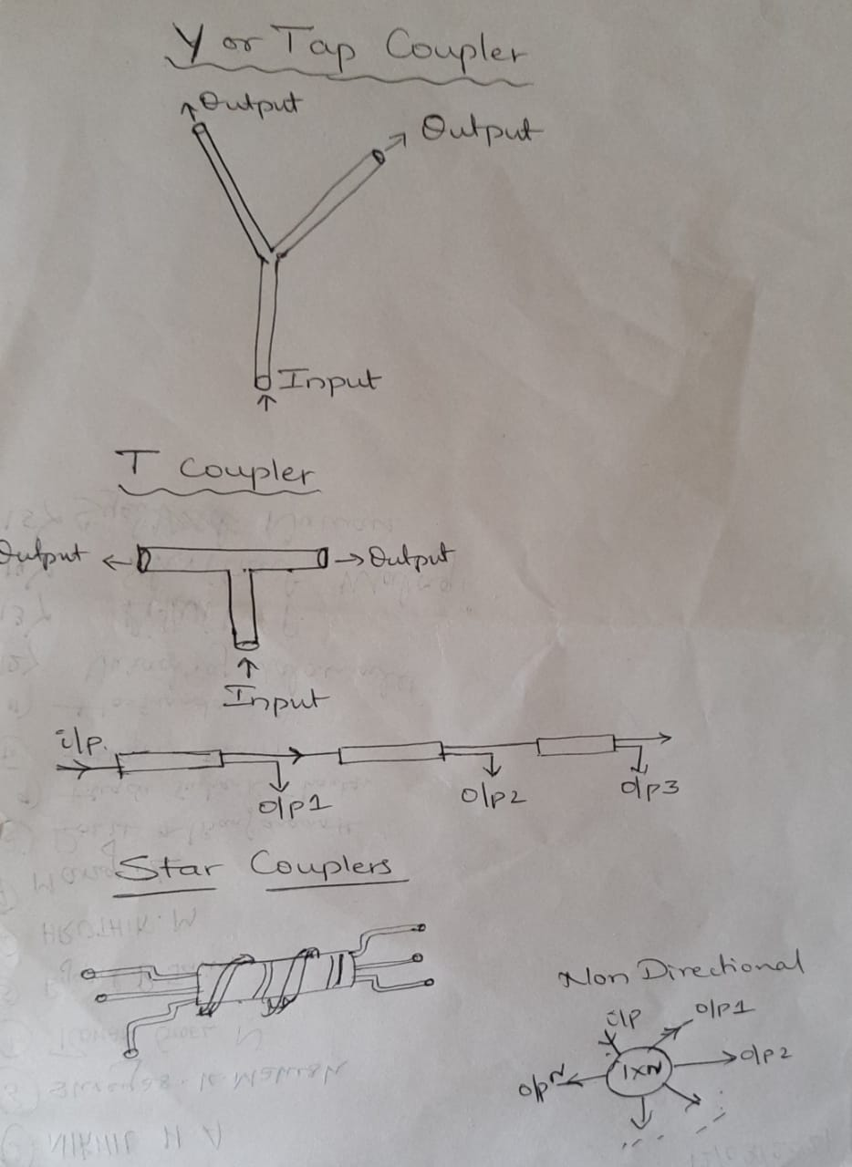

Slide 13
Lensing Schemes for Coupling Improvement
power coupling efficiency becomes poor.
miniature lens is placed between source and fiber.
Micro lens magnifies the emitting area of source equal to core area.
The power coupled increases by a factor equal to magnification factor of lens.
Important types of lensing schemes are:
Rounded – end fiber.
Spherical – surfaced LED and Spherical-ended fiber.
Taper ended fiber.
Non imaging microsphere.
Cylindrical lens
Imaging sphere

Slide 14
